Slide 1

MUSIC RECOMMENDER SYSTEM
Presented by →
Vinay Panwar
Vaishnavi Kaushal
Rupali Wanare

Slide 2
Under the guidance of our respectable supervisor Dr. Sachine Patel and Co- supervisor Sadhna Pandey, We have done a Project name as Music Recommender system. To start with we thought of a recommender system but after realizing we had so many area of studies to cover, but with the valuable guidance we decided to move with Music recommender system.
Now we will give you all presented a brief overview of our problem with the work we had done till now.

Slide 3
Content
Introduction
Solution
Snapshots
Drawbacks
Summary

Slide 4
Introduction :-
The recommender system can predict whether a particular user would prefer an item or not based on the user’s profile.
The Recommender system is a system that helps an algorithm or device to guess something for their respective users. With this idea in our mind, we choose to work on a recommender system that helps the user to understand their day-to-day requirements and make their decisions with clearer information in mind.

Slide 5

Solution
We created a GUI which need a set of inputs such as user’s searches and some question’s answer, and based on the answer given, our system processes that data and recommend one of these Music (music, book or movie or may be all of these).
We used Spotipy API for list of songs as we couldn’t store billions of songs in a single PC and search through them.
We used python programming language as medium to design the idea we had in our mind. There are some of the Snap shots are attached below for just a glance.

Slide 6
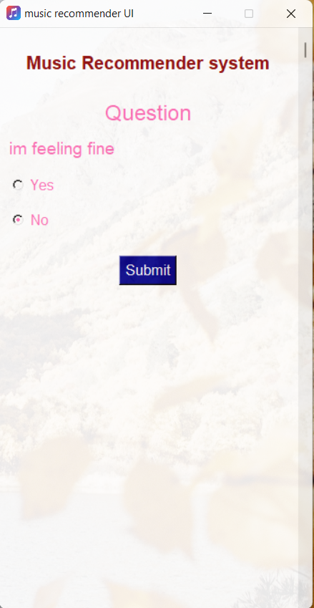
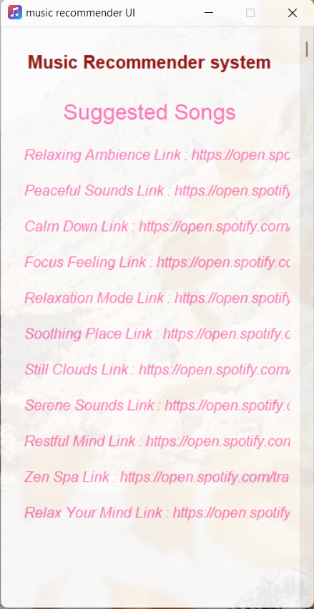
Home window
Suggestion window

Slide 7
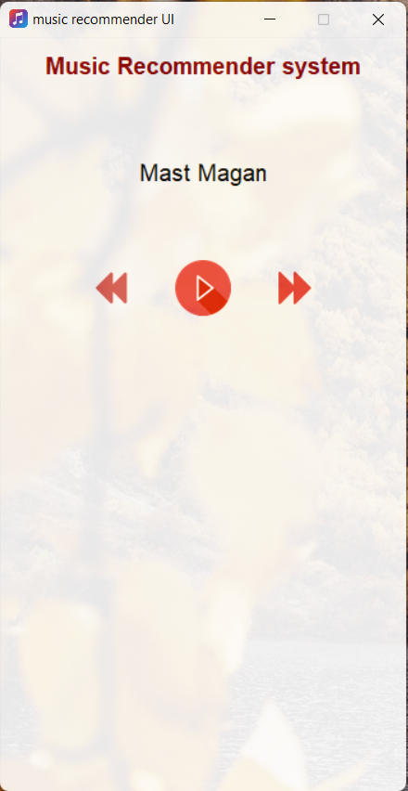
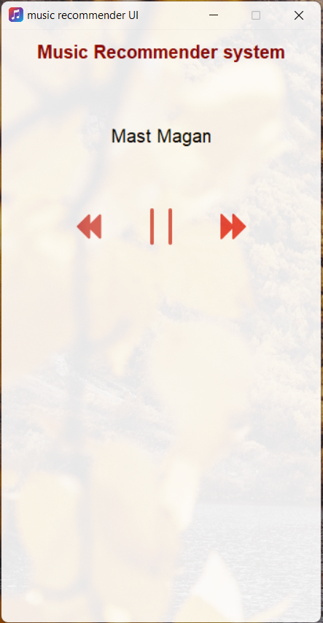
Play window
Resume window

Slide 8

Drawbacks
Presently we are only able to suggest list of songs to respective user. Play song or say streaming song is out of our reach but we are trying our best to upgrade it more and show our best work in upcoming upgrades.

Slide 9
Final words
As we knew and experienced throughout the process the developing and software and making it available to users is more complicated, but we are glad to work with our mentor and as a product of guidance we made something and expecting more to improvise our lacks.

Slide 10

Thank you

